Slide 1

TELEPHONE DIRECTORY MANAGEMENT SYSTEM
Maram Vignesh

Slide 2
OVERVIEW
To start with, in general Telephone Directory is a book which consists of the details of various persons including their phone number and address.
Its main purpose is to obtain details of a person using their name or phone number.Also we can add, delete and edit the members of the directory.
So here, we made a project on the same using OOPS concepts like Inheritance, Polymorphism, Composition, File handling etc.
We also separated Interface from Implementation for code reusability and encapsulation.

Slide 3
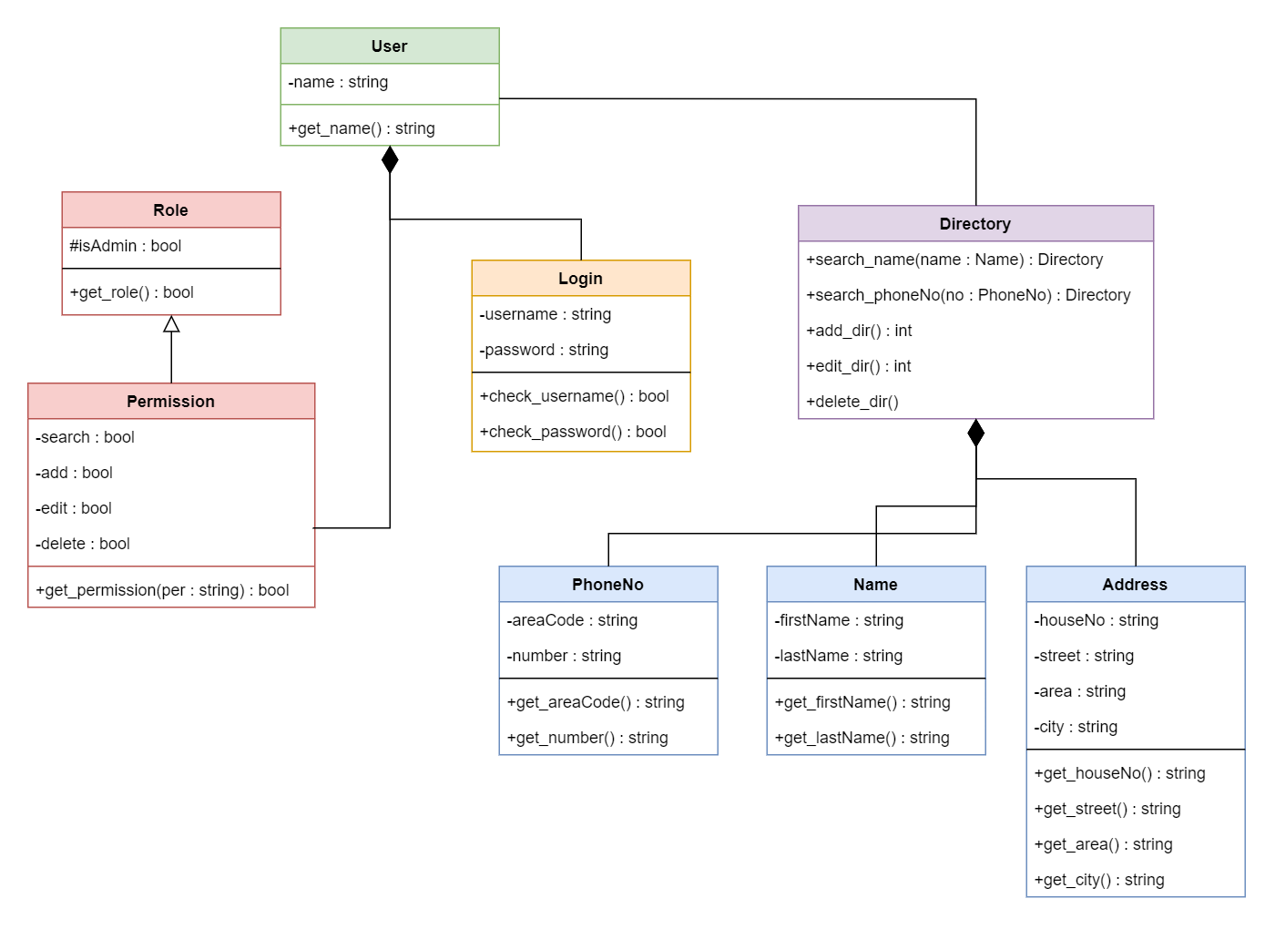
CLASS DIAGRAM

